Slide 1
Introduction to ARIMA Models
Auto Regressive Integrated Moving Average’ is actually a class of models that ‘explains’ a given time series based on its own past values, that is, its own lags and the lagged forecast errors, so that equation can be used to forecast future values. Any ‘non-seasonal’ time series that exhibits patterns and is not a random white noise can be modeled with ARIMA models.

Slide 2
ARIMA model
An ARIMA model is characterized by 3 terms: p, d, q
p is the order of the AR term
q is the order of the MA term
d is the number of differencing required to make the time series stationary
Notes:
https://www.machinelearningplus.com/time-series/arima-model-time-series-forecasting-python/
If a time series, has seasonal patterns, then you need to add seasonal terms and it becomes SARIMA, short for ‘Seasonal ARIMA’. More on that once we finish ARIMA.

Slide 3
What is D?
To make a series stationary?
The most common approach is to difference it. That is, subtract the previous value from the current value. Sometimes, depending on the complexity of the series, more than one differencing may be needed.
The value of d, therefore, is the minimum number of differencing needed to make the series stationary. And if the time series is already stationary, then d = 0.

Slide 4
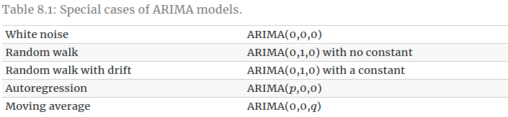
Next, what are the ‘p’ and ‘q’ terms?
‘p’ is the order of the ‘Auto Regressive’ (AR) term. It refers to the number of lags of Y to be used as predictors. And ‘q’ is the order of the ‘Moving Average’ (MA) term. It refers to the number of lagged forecast errors that should go into the ARIMA Model.

Slide 5
How to find the order of differencing (d) in ARIMA model
The purpose of differencing it to make the time series stationary.
But you need to be careful to not over-difference the series. Because, an over differenced series may still be stationary, which in turn will affect the model parameters.
The right order of differencing is the minimum differencing required to get a near-stationary series which roams around a defined mean and the ACF plot reaches to zero fairly quick.
If the autocorrelations are positive for many number of lags (10 or more), then the series needs further differencing. On the other hand, if the lag 1 autocorrelation itself is too negative, then the series is probably over-differenced.
In the event, you can’t really decide between two orders of differencing, then go with the order that gives the least standard deviation in the differenced series.

Slide 6
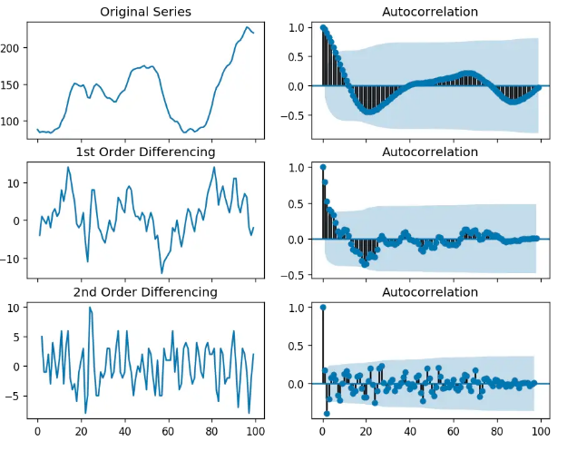
the time series reaches stationarity with two orders of differencing. But on looking at the autocorrelation plot for the 2nd differencing the lag goes into the far negative zone fairly quick, which indicates, the series might have been over differenced.
So, we can tentatively fix the order of differencing as 1 even though the series is not perfectly stationary (weak stationarity).

Slide 7
The basic guideline for interpreting the ACF and PACF plots are as following:
Look for tail off pattern in either ACF or PACF.
If tail off at ACF → AR model → Cut off at PACF will provide order p for AR(p).
If tail off at PACF → MA model → Cut off at ACF will provide order q for MA(q).
Tail of at both ACF and PACF → ARMA model

Slide 8
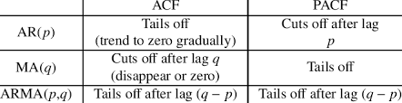

Slide 9
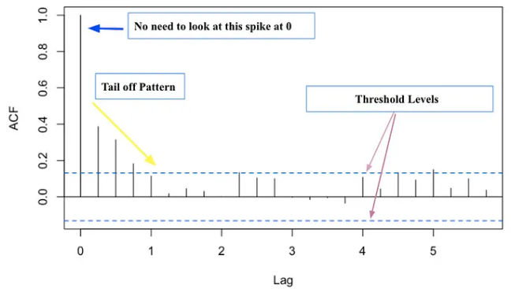
ACF
The two blue dash lines pointed by purple arrows represent the significant threshold levels. Anything that spikes over these two lines reveals the significant correlations.
When looking at ACF plot, we ignore the long spike at lag 0 (pointed by the blue arrow).

Slide 10
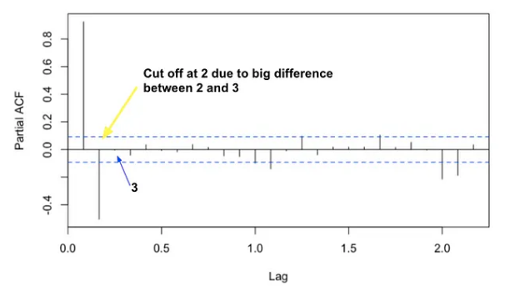
PACF
For PACF, the line usually starts at 1.
The lag axes will be different depending on the times series data.
Notes:
https://medium.com/@ooemma83/how-to-interpret-acf-and-pacf-plots-for-identifying-ar-ma-arma-or-arima-models-498717e815b6

Slide 11
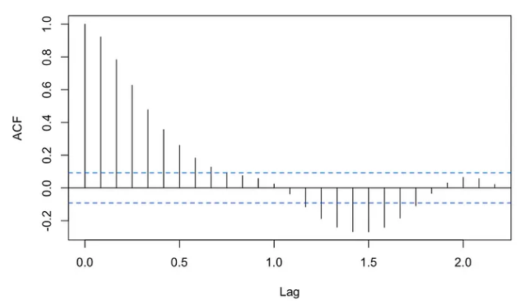
How to find the order of the AR term (p)
Here’s the ACF for AR model.
Tail off is observed at ACF plot. Thus, it’s a AR model.

Slide 12
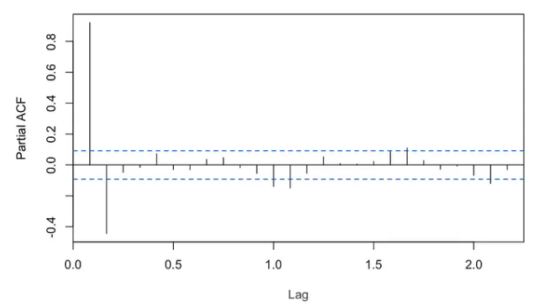
How to find the order of the AR term (p)
Here’s PACF plots of the AR model.
From PACF, cut off happens at lag 2. Thus, the order is 2. So it should be AR(2) model.

Slide 13
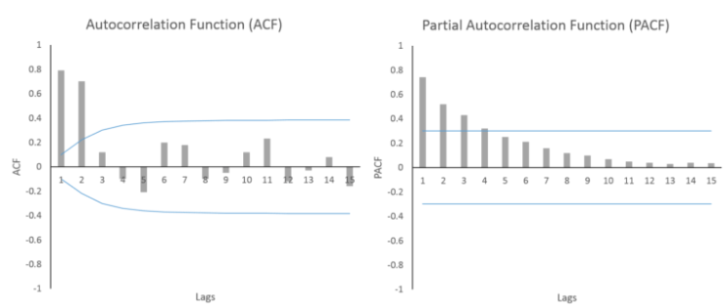
How to find the order of the MA term (q)
MA process shows a gradually geometrically declining PACF and the ACF has a few significant lags. This is the opposite of the AR process above.
Here, the PACF is falling geometrically and the ACF has 2 significant lags before dropping. This indicates MA(2) process
Notes:
https://spureconomics.com/interpreting-acf-and-pacf-plots/#:~:text=MA%20process%20shows%20a%20gradually,indicates%20MA(2)%20process.

Slide 14
ARMA vs ARIMA
The difference between ARMA and ARIMA is the integration part. The integrated I stands for the number of times differencing is needed to make the times series stationary.

Slide 15
ARMA Model Equation
r(t)=C+φr(t-1)+θε(t-1)+ε(t) where,
r(t),r(t-1) = current value and value one period ago.
ε(t),ε(t-1) = current error term and one period ago.
c = baseline constant factor.
φ = value coefficient, what part of the last period value is relevant in explaining the current value.
θ = error coefficient, what part of the last period value is relevant in explaining the current error value.
2. ARIMA Model Equation
Δr(t)=C+φΔr(t-1)+θε(t-1)+ε(t), where,
Δr(t)= r(t)-r(t-1) , difference in consecutive period.
other is same as the ARMA model.
Notes:
https://varshasaini.in/questions/what-is-the-difference-between-arima-and-arma-model/

Slide 16
How to handle if a time series is slightly under or over differenced
It may so happen that your series is slightly under differenced, that differencing it one more time makes it slightly over-differenced.
How to handle this case?
If your series is slightly under differenced, adding one or more additional AR terms usually makes it up. Likewise, if it is slightly over-differenced, try adding an additional MA term.

Slide 17
Vector Autoregression
The primary difference is those models are uni-directional, where, the predictors influence the Y and not vice-versa. Whereas, Vector Auto Regression (VAR) is bi-directional. That is, the variables influence each other.
Notes:
https://www.machinelearningplus.com/time-series/vector-autoregression-examples-python/

Slide 18
How does a VAR model’s formula look like?
In the VAR model, each variable is modeled as a linear combination of past values of itself and the past values of other variables in the system. Since you have multiple time series that influence each other, it is modeled as a system of equations with one equation per variable (time series).
That is, if you have 5 time series that influence each other, we will have a system of 5 equations.

Slide 19
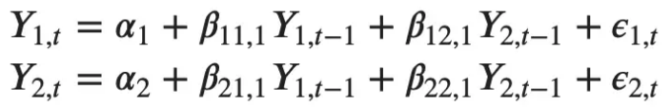
Equation
Let’s suppose, you have two variables (Time series) Y1 and Y2, and you need to forecast the values of these variables at time (t). To calculate Y1(t), VAR will use the past values of both Y1 as well as Y2. Likewise, to compute Y2(t), the past values of both Y1 and Y2 be used.
For example, the system of equations for a VAR(1) model with two time series (variables `Y1` and `Y2`) is as follows:
Where, Y{1,t-1} and Y{2,t-1} are the first lag of time series Y1 and Y2 respectively.
The above equation is referred to as a VAR(1) model, because, each equation is of order 1, that is, it contains up to one lag of each of the predictors (Y1 and Y2).
Since the Y terms in the equations are interrelated, the Y’s are considered as endogenous variables, rather than as exogenous predictors.

Slide 20
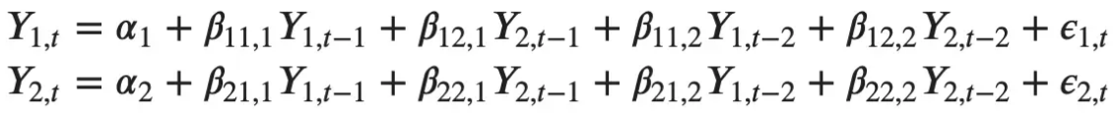
Likewise, the second order VAR(2) model for two variables would include up to two lags for each variable (Y1 and Y2).

Slide 21
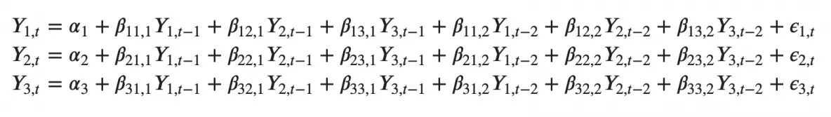
As you increase the number of time series (variables) in the model the system of equations become larger.
Can you imagine what a second order VAR(2) model with three variables (Y1, Y2 and Y3) would look like?

Slide 22
Advantages of Statistical models
These models are simple and transparent, so they can be understood clearly in terms of their parameters.
• You can apply these models to fairly small data sets and still get good results.
• These simple models and related modifications perform extremely well, even in comparison to very complicated machine learning models. So you get good performance without the danger of overfitting.
• Well-developed automated methodologies for choosing orders of your models and estimating their parameters make it simple to generate these forecasts.

Slide 23
Disdvantages of Statistical models
• Because these models are quite simple, they don’t always improve performance when given large data sets. If you are working with extremely large data sets, you may do better with the complex models of machine learning and neural network methodologies.
• These statistical models put the focus on point estimates of the mean value of a distribution rather than on the distribution. True, you can derive sample variances and the like as some proxy for uncertainty in your forecasts, but your fundamental model offers only limited ways to express uncertainty relative to all the choices you make in selecting a model.
• By definition, these models are not built to handle nonlinear dynamics and will do a poor job describing data where nonlinear relationships are dominant.

Slide 24
Hidden Markov Model

Slide 25
What are Markov Models?
Markov models are a type of probabilistic model that is used to predict the future state of a system, based on its current state.
In other words, Markov models are used to predict the future state based on the current hidden or observed states. Markov model is a finite-state machine where each state has an associated probability of being in any other state after one step. They can be used to model real-world problems where hidden and observable states are involved.
Markov models can be classified into hidden and observable based on the type of information available to use for making predictions or decisions.
Hidden Markov models deal with hidden variables that cannot be directly observed but only inferred from other observations, whereas in an observable model also termed as Markov chain, hidden variables are not involved.

Slide 26
Markov models
Say you have a bag of marbles that contains four marbles: two red marbles and two blue marbles. You randomly select a marble from the bag, note its color, and then put it back in the bag. After repeating this process several times, you begin to notice a pattern: The probability of selecting a red marble is always two out of four, or 50%. This is because the probability of selecting a particular color of marble is determined by the number of that color of marble in the bag. In other words, the past history (i.e., the contents of the bag) determines the future state (i.e., the probability of selecting a particular color of marble).
Notes:
This example illustrates the concept of a Markov model: the future state of a system is determined by its current state and past history. In the case of the bag of marbles, the current state is determined by the number of each color of marble in the bag. The past history is represented by the contents of the bag, which determine the probabilities of selecting each color of marble.
Markov models have many applications in the real world, including predicting the weather, stock market prices, and the spread of disease. Markov models are also used in natural language processing applications such as speech recognition and machine translation. In speech recognition, Markov models are used to identify the correct word or phrase based on the context of the sentence. In machine translation, Markov models are used to select the best translation for a sentence based on the translation choices made for previous sentences in the text.

Slide 27
What is Markov Chain?
Initial probability distribution: An initial probability distribution over states, πi is the probability that the Markov chain will start in a certain state i. Some states j may have πj = 0, meaning that they cannot be initial states
One or more states
Transition probability distribution: A transition probability matrix A where each a_ij represents the probability of moving from state I to state j
Notes:
Markov chains have the Markov property, which states that the probability of moving to any particular state next depends only on the current state and not on the previous states.

Slide 28
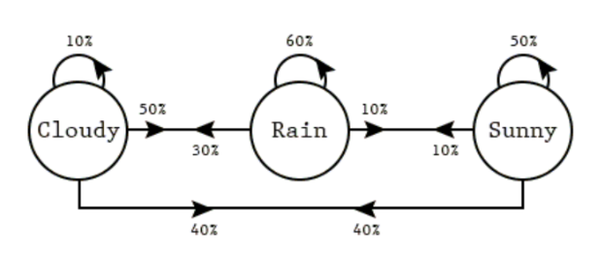
If rainy today, then tomorrow:
10% probability for sunny
60% probability for rainy
30% probability for cloudy
If rainy today, then tomorrow:
10% probability for sunny
60% probability for rainy
30% probability for cloudy
If cloudy today, then tomorrow:
40% probability for sunny
50% probability for rainy
10% probability for cloudy
Notes:
The diagram represents a Markov chain where there are three states representing the weather of the day (cloudy, rainy, and sunny). And, there are transition probabilities representing the weather of the next day given the weather of the current day.

Slide 29
Using this Markov chain, what is the probability that the Wednesday will be cloudy if today is sunny. The following are different transitions that can result in a cloudy Wednesday given today (Monday) is sunny.
Sunny – Sunny (Tuesday) – Cloudy (Wednesday): The probability to a cloudy Wednesday can be calculated as 0.5 x 0.4 = 0.2
Sunny – Rainy (Tuesday) – Cloudy (Wednesday): The probability of a cloudy Wednesday can be calculated as 0.1 x 0.3 = 0.03
Sunny – Cloudy (Tuesday) – Cloudy (Wednesday): The probability of a cloudy Wednesday can be calculated as 0.4 x 0.1 = 0.04
The total probability of a cloudy Wednesday = 0.2 + 0.03 + 0.04 = 0.27.

Slide 30
Hidden Markov model
HMM is a statistical model in which the system being modeled are Markov processes with unobserved or hidden states. It is a hidden variable model which can give an observation of another hidden state with the help of the Markov assumption. The hidden state is the term given to the next possible variable which cannot be directly observed but can be inferred by observing one or more states according to Markov’s assumption.

Slide 31
Hidden Markov models.
Set of states:
Process moves from one state to another generating a sequence of states :
Markov chain property: probability of each subsequent state depends only on what was the previous state:
States are not visible, but each state randomly generates one of M observations (or visible states )
To define hidden Markov model, the following probabilities have to be specified: matrix of transition probabilities A=(a_{ij}), a_{ij}= P(s_{i} | s_{j}) , matrix of observation probabilities B=(b_{i} (v_{m} )), b_{i}(v_{m} ) = P(v_{m} | s_{i}) and a vector of initial probabilities π=(π_{i}), π_{i} = P(s_{i}) . Model is represented by M=(A, B, π).

Slide 32
Kalman filter

Slide 33

A Kalman filter is an optimal estimation algorithm.

Slide 34
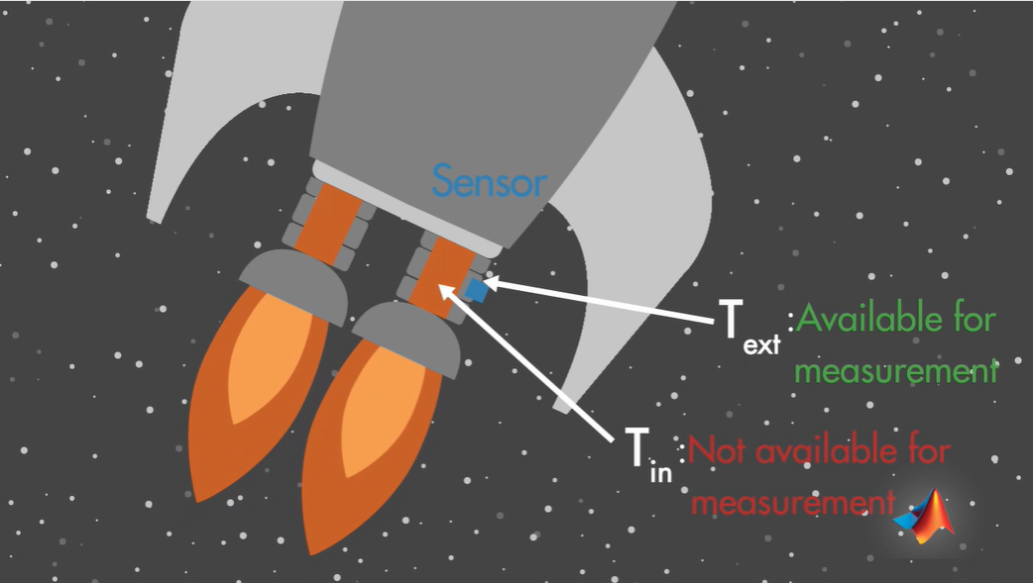
Notes:
To illustrate this, let's go to Mars before anyone else does. If your spacecraft's engine can burn fuel at a high enough temperature, it can create thrust that will let you fly to Mars. By the way, according to NASA, liquid hydrogen is a light and powerful rocket propellant that burns with extreme intensity at 5,500 degrees Fahrenheit.
But be careful, because at too-high temperature it can put the mechanical components of the engine at risk, and this can lead to the failure of some of the mechanical parts. If that happens, you might be stuck in your small spacecraft where you've got to eat from tubes. To prevent such a situation, you should closely monitor internal temperature of the combustion chamber. This is not an easy task, since a sensor placed inside the chamber would melt.
Instead, it needs to be placed on a cooler surface close to the chamber. The problem you are facing here is that you want to measure internal temperature of the chamber, but you can't. Instead you have to measure external temperature. In this situation, you can use a Kalman filter to find the best estimate of the internal temperature from an indirect measurement. This way you're extracting information about what you can't measure from what you can.
If it gets too hot, it could damage your spacecraft. However, there isn't any feasible way of measuring the internal temperature, since a sensor placed inside the engine would melt.
What you can do is to place the sensor on a colder surface and measure the temperature there. Let's call this temperature t external, and the one you can't measure but you need to estimate, t internal. This is your rocket. You're wondering how high the internal temperature of the engine is, since this will tell you how you should regulate the fuel flow to your rocket.

Slide 35
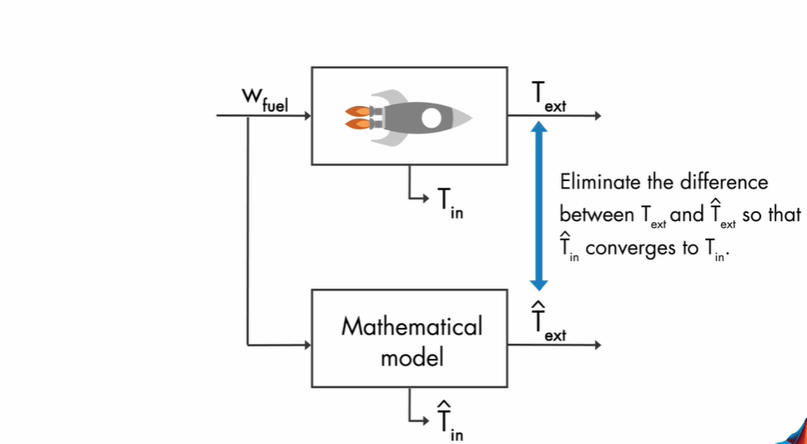
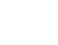
Notes:
However, you don't have access to the state t internal. Instead, you can measure t external. The signals that are available to you are the fuel flow and your measurements. How do you estimate the internal temperature? Actually, you have access to more information. Since your method's pretty good, you can derive the equations that will give you the mathematical model of your real system.
You already know how much fuel you're adding to your rocket, so if you now input this fuel flow to your mathematical model, this will give you an estimate of your output. And also, notice that since you have all the governing equations, you can even calculate the internal state of the system.
Okay, does this solve your problem now? Unfortunately, it doesn't. No doubt that you're good at math, but , the mathematical model you found is only an approximation of your real system. It is subject to uncertainties. If you had a perfect model without any uncertainties, and if your real system and your model had the same initial conditions, then your measurement and estimated output values would match each other.
And therefore, the estimate of the internal temperature would match the true internal temperature as well. But in real life, this is an unlikely scenario, and therefore, the estimated external temperature won't match the measured temperature. That's why you need to use a state estimator to estimate your internal states.
Let's see how a state estimator works. Here, our goal is to match the estimated external temperature with the measured external temperature. We know that if these two are equal, then the model will converge to the real system. So the estimated internal temperature will converge to its true value.
What we're trying to do is to minimize the difference between the estimated and measured external temperature.

Slide 36
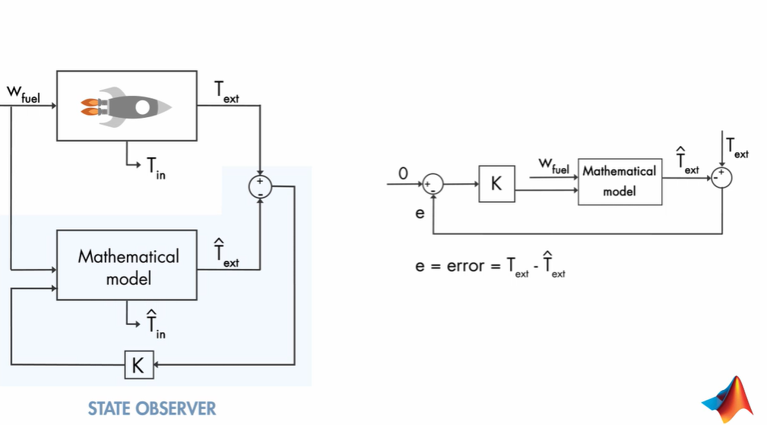
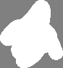
Notes:
Actually, we're talking about a feedback control system, where we try to control the error between the measured and estimated external temperature at 0 using a controller k.
If we now update our diagram on the left-hand side based on what we've discussed here, it will look like this. This part represents the state observer. By closing the loop with a controller k around the observer, we try to eliminate the error between the estimated and measured external temperature such that the estimated internal temperature is driven to its true value.
In summary, you can't directly measure the internal engine temperature, but you know how much fuel you're supplying to your rocket. So you can run this through your mathematical model and estimate the output, which you can then use along with your real measurements to estimate the internal state of the system.

Slide 37
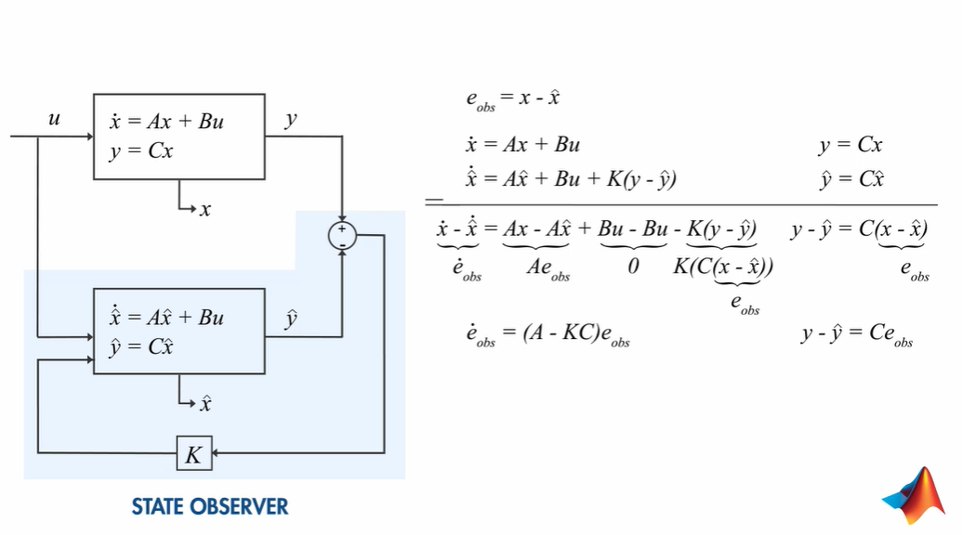
Notes:
let's look at how we can explain the state observer mathematically. We will generalize the problem and show the input as u, the output as y, and any states we want to estimate as x.
Our goal is to derive x hat to x, so we can define the difference between these values as an error. Next, let's write down the equations for the system and the observer. If we subtract these equations from each other, this will give us the error dynamics. By rearranging terms, we see that the aerodynamics can be shown by this equation.

Slide 38
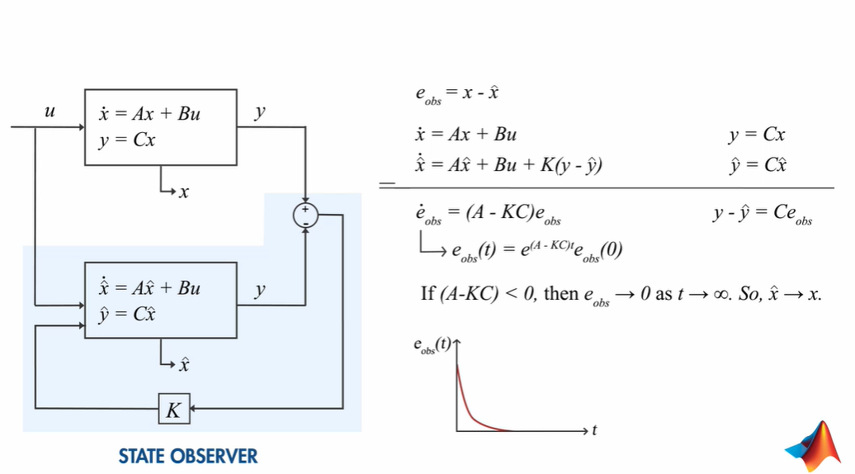
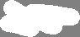
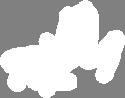
Notes:
The solution to this equation is an exponential function. What this means is if this term is less than zero, we're good because we know that our error will vanish over time, and x hat will converge to x. At this point, you may be asking if we really need the kc term in this equation, because even without the feedback loop that adds the kc term to the equation, we will have a decaying exponential function for the error.
The significance of having a feedback loop around the observer is that we can control the decaying rate of the error function by selecting the controller gain k accordingly. However, here the decay rates solely depends on the matrix a. And if there are some uncertainties in the mathematical model, this means you don't know a exactly.
Therefore, you can't control how quickly the error will vanish. Having the feedback controller gives you more control over this equation and guarantees a faster elimination of the error. And the faster the error vanishes, the faster the estimated states x hat converge to the true states x. An optimal way of choosing the gain k is performed through the use of Kalman filters.

Slide 39
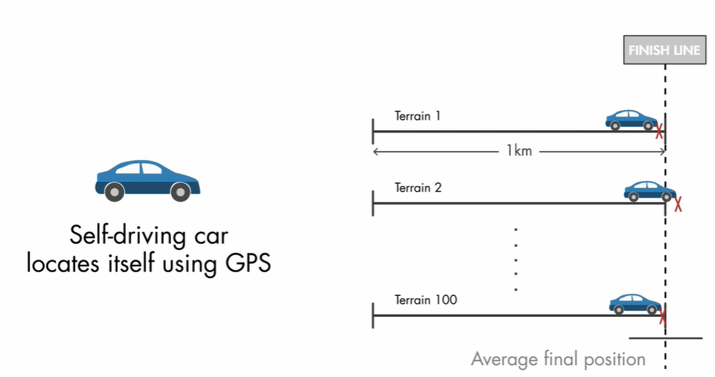
Notes:
An optimal state estimator
Your car is supposed to drive 1 kilometer on 100 different terrains. Each time, it must stop as close as possible to the finish line. At the end of the competition, the average final position is computed for each team, and the owner of the car with the smallest error variance and average final position closest to 1 kilometer gets the big prize.

Slide 40
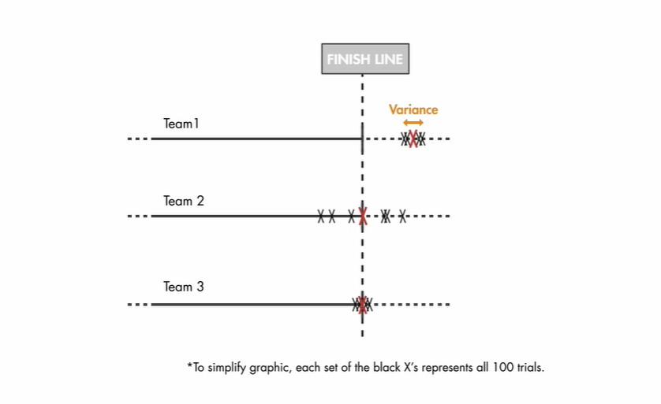
Notes:
Here's an example. Let these points represent the final position, and the red ones the average final position for different teams. Based on these results, Team 1 would lose due to the biased average final position, although it has small variance. Team 2 would lose as well. Its average final position is on the finish line, but it has high variance. The winner will be Team 3, since it has the smallest variance, and its average final position is on the finish line.
In order to meet the required criteria to win the competition, you can estimate the car's position using a Kalman filter. Let's look at the system to understand how the Kalman filter works.

Slide 41
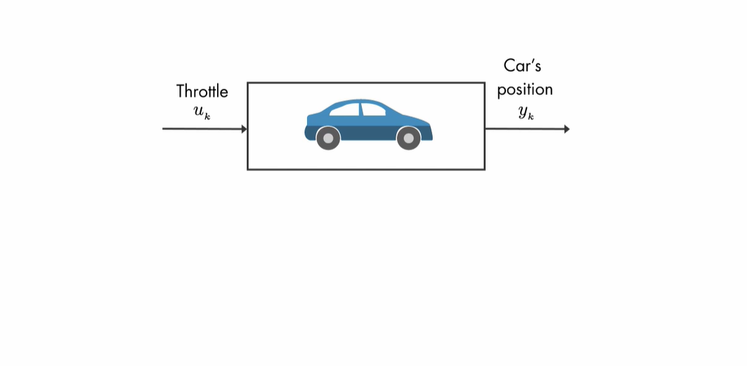
Notes:
The input to the car is a throttle. The output that we're interested in is the car's position.

Slide 42
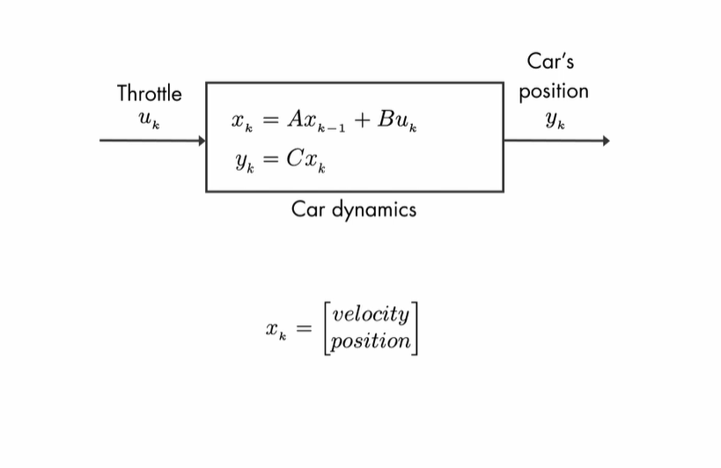
Notes:
But here, to give you intuition, we'll assume an overly simplistic system, where the input to the car is the velocity.

Slide 43
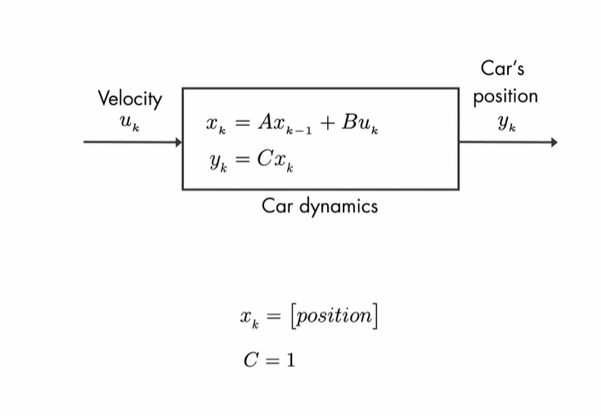
Notes:
This system will have a single state, the car's position. And we're measuring the states so matrix C is equal to 1.

Slide 44
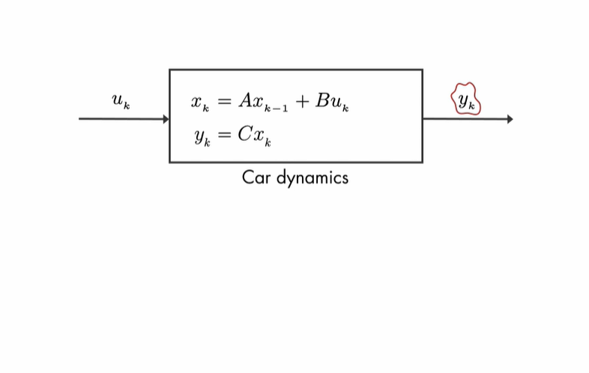
Notes:
It's important to know y as accurately as possible, since we want the car to finish as close as possible to the finish line.

Slide 45
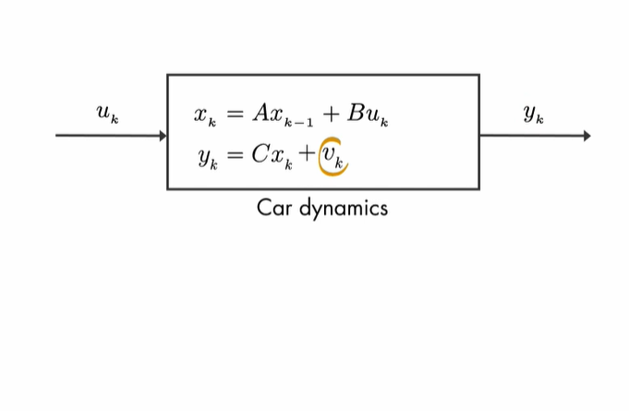
Notes:
But the GPS readings will be noisy. We'll show this measurement noise with v, which is a random variable.

Slide 46
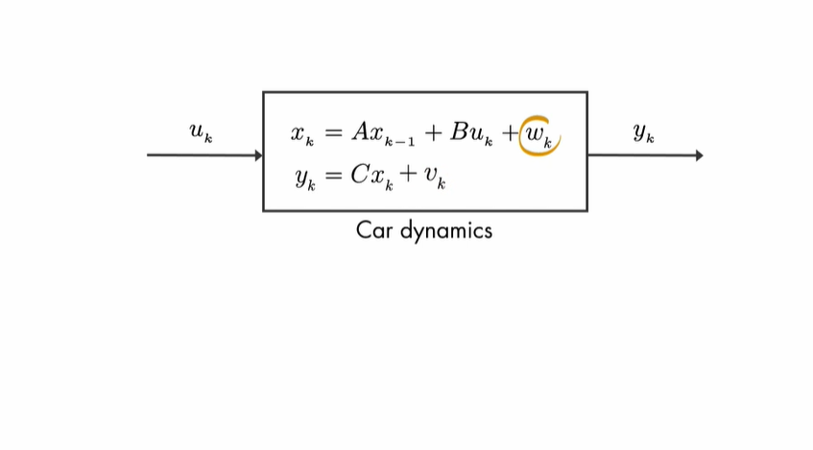
Notes:
Similarly, there is process noise, which is also random and can represent the effects of the wind or changes in the car's velocity.

Slide 47
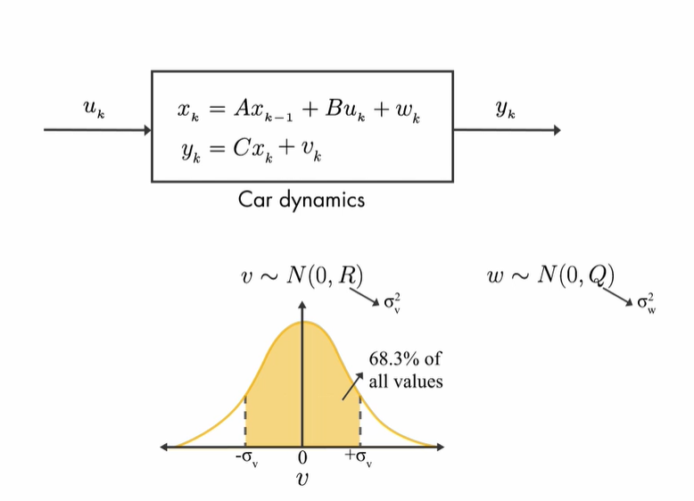
Notes:
Although these random variables don't follow a pattern, using probability theory, we can tell something about their average properties. v, for example, is assumed to be drawn from a Gaussian distribution with zero mean and covariance R. This means if we measured the position of the car, let's say 100 times at the same location, the noise in these readings will take on values, with most of them located near to zero mean and fewer located farther away from it. And this results in the Gaussian distribution, which is described by the covariance R.
Since we have a single output system, the covariance R is scalar and is equal to the variance of the measurement noise. Similarly, the process noise is also random and assumes a Gaussian distribution with covariance Q. Now, we know that the measurement is noisy, and therefore what we measure doesn't quite reflect the true position of the car.

Slide 48
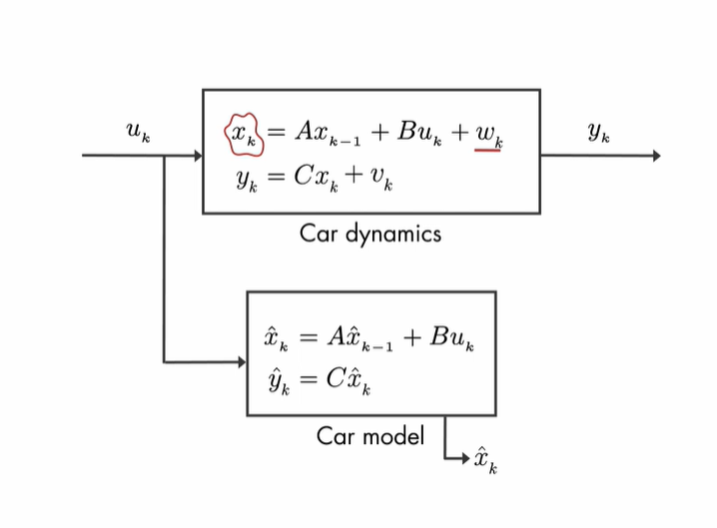
Notes:
Now, we know that the measurement is noisy, and therefore what we measure doesn't quite reflect the true position of the car. If we know the car model, we can run the input through it to estimate the position. But this estimate also won't be perfect, because now we're estimating x, which is uncertain due to the process noise.

Slide 49
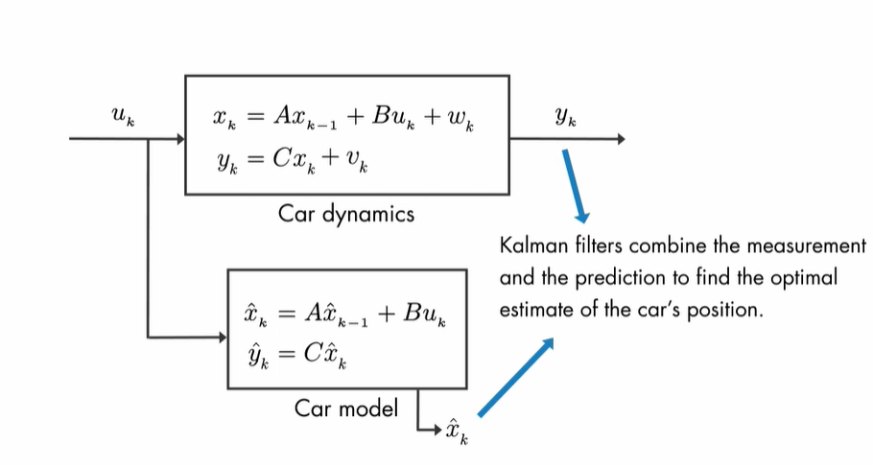
Notes:
This is where the Kalman filter comes into play. It combines these two pieces of information to come up with the best estimate of the car's position in the presence of process and measurement noise.

Slide 50
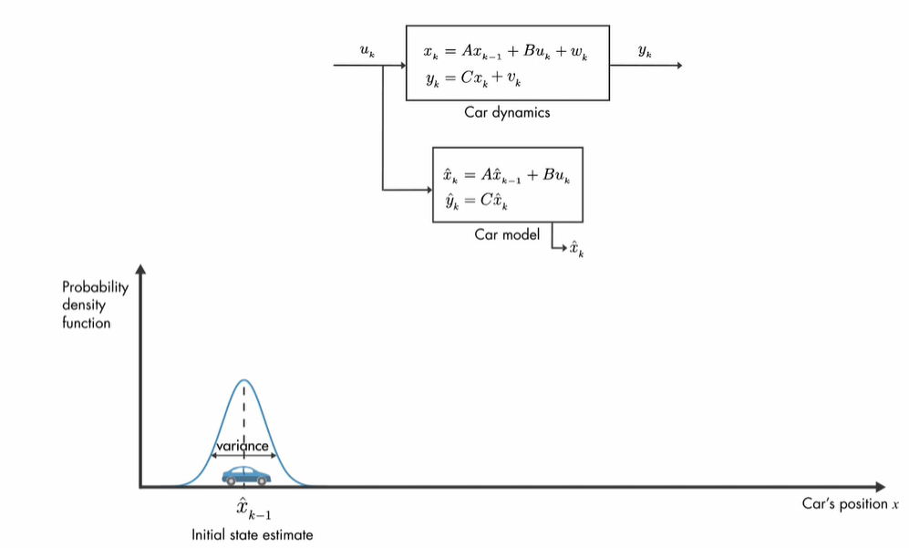
Notes:
We'll discuss the working principle of the Kalman filter visually with the help of probability density functions. At the initial time step, k minus 1, the actual car position can be anywhere around the estimate x hat k minus 1. And this uncertainty is described by this probability density function.
What this plot also tells us is that the car is going to be most likely around the mean of this distribution.

Slide 51
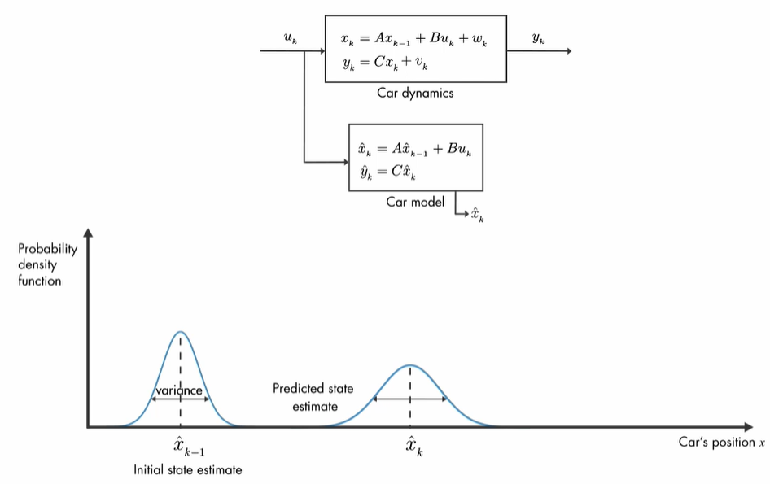
Notes:
At the next time step, the uncertainty in the estimate has increased, which is shown with the larger variance. This is because between time step k minus 1 and k, the car might have run over a pothole, or maybe the wheels may have slipped a little bit. Therefore, it may have traveled a different distance than what we have predicted by the model.

Slide 52
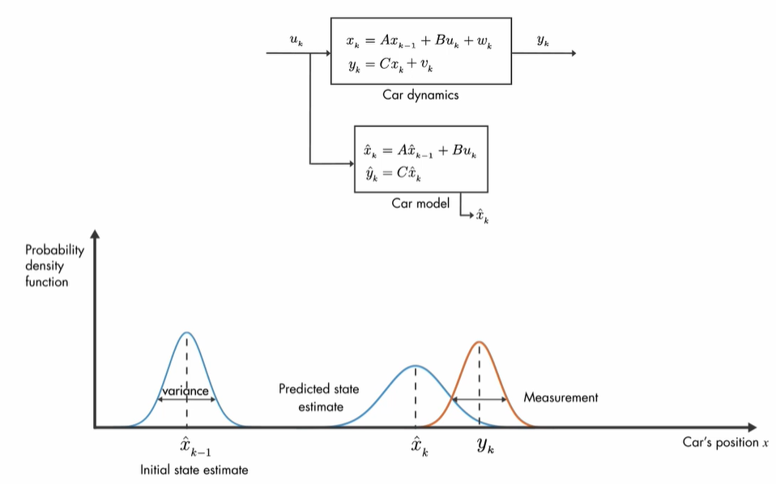
Notes:
As we discussed before, another source of information on car's position comes from the measurement. Here the variance represents the uncertainty in the noise measurement. Again, the true position can be anywhere around the mean.

Slide 53
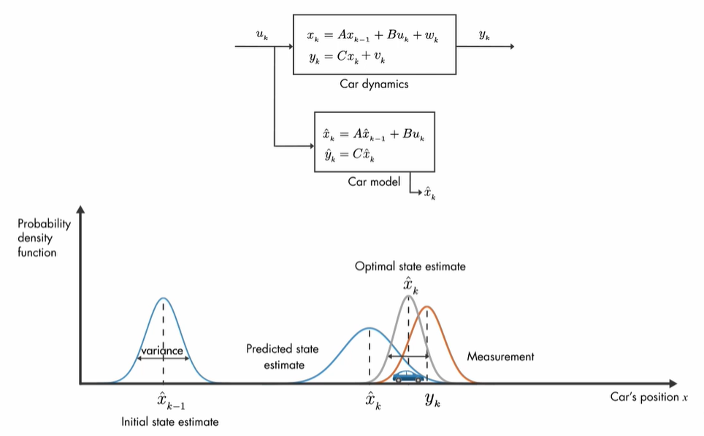
Notes:
Now that we have the prediction and measurement, the question is, what is the best estimate of the car's position? It turns out that the optimal way to estimate the car's position is by combining these two pieces of information. And this is done by multiplying these two probability functions together. The resulting product is also a Gaussian function.
This estimate has a smaller variance than either of the previous estimates, and the mean of this probability density function gives us the optimal estimate of the car's position. This is the basic idea behind Kalman filters.

Slide 54
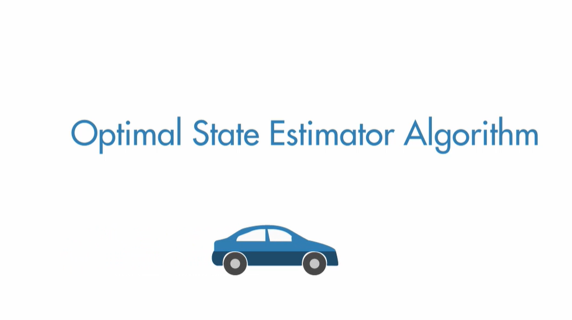
Notes:
we'll discuss the set of equations that you need to implement the Kalman filter algorithm. Let's revisit the example
You join a competition to win the big prize. You're asked to design a self-driving car that needs to drive one kilometer on 100 different terrains.

Slide 55
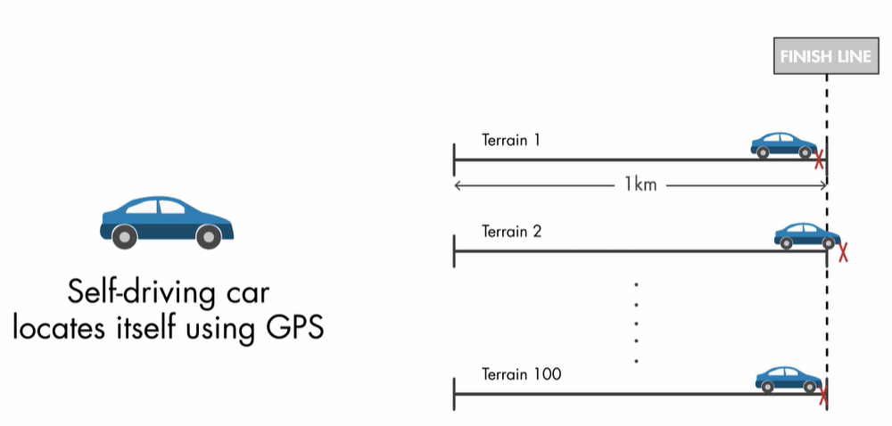
Notes:
n each trial, the car must stop as close as possible to the finish line.

Slide 56
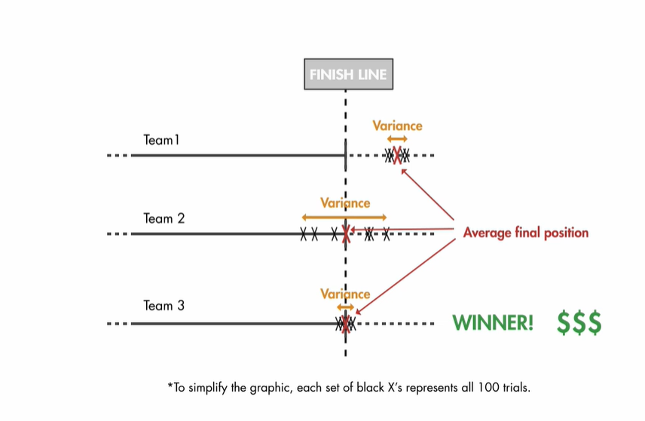
Notes:
At the end of the competition, the average trial position is computed for each team, and the owner of the car with the smallest error variance in an average trial position closest to 1 kilometer gets the big prize.

Slide 57
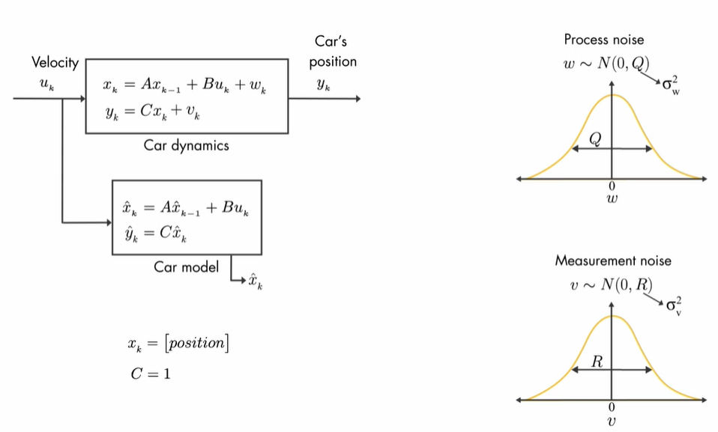
Notes:
In that example, we also showed the car dynamics and the car model for our single-state system, and we discussed process and measurement noises along with the covariances.
Xk-1 is the just previous state, xk is the state we need to determine, yk is the output

Slide 58
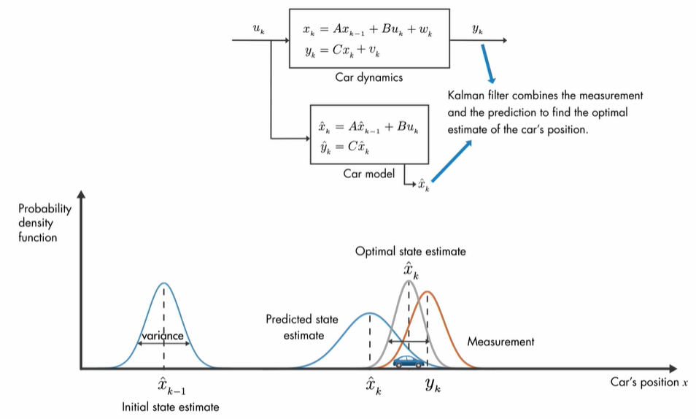
Notes:
Finally, we said that you could win the competition by using a Kalman filter, which computes an optimal, unbiased estimate of the car's position with minimal variance.

Slide 59
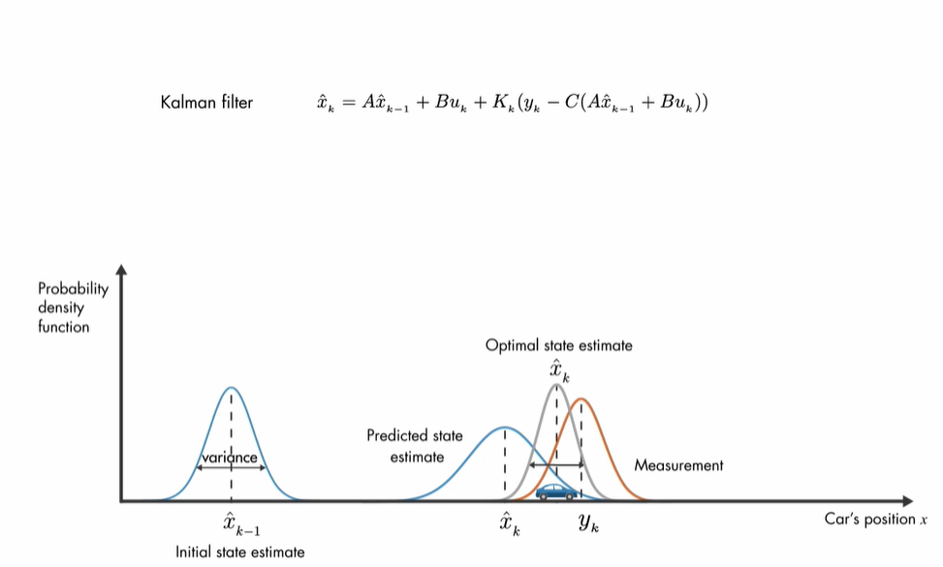
Notes:
This optimal estimate is found by multiplying the prediction and measurement probability functions together, scaling the results, and computing the mean of the resulting probability density function. Computationally, the multiplication of these two probability density functions relates to the discrete Kalman filter equation shown here.

Slide 60
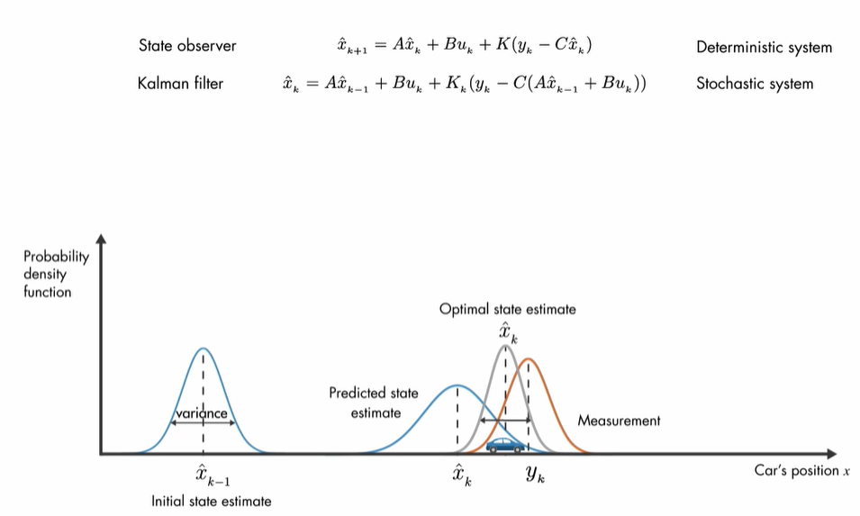
Notes:
it look similar to the state observer equation that we discussed in previous videos? Actually, a Kalman filter is a type of state observer, but it is designed for stochastic systems. Here is how the Kalman filter equation relates to what we've discussed with the probability density functions.

Slide 61
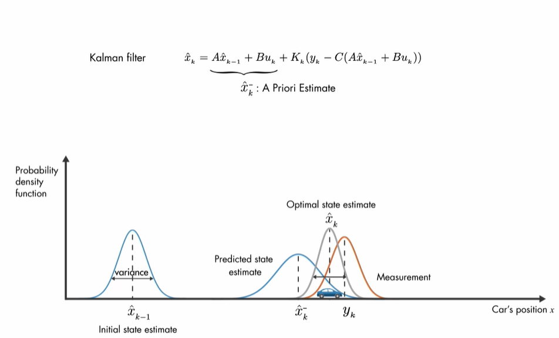
Notes:
The first part predicts the current state by using state estimates from the previous timestep and the current input. Note that these two state estimates are different from each other. We'll show the predicted state estimate with this notation. This is also called the a priori estimate, since it is calculated before the current measurement is taken.

Slide 62
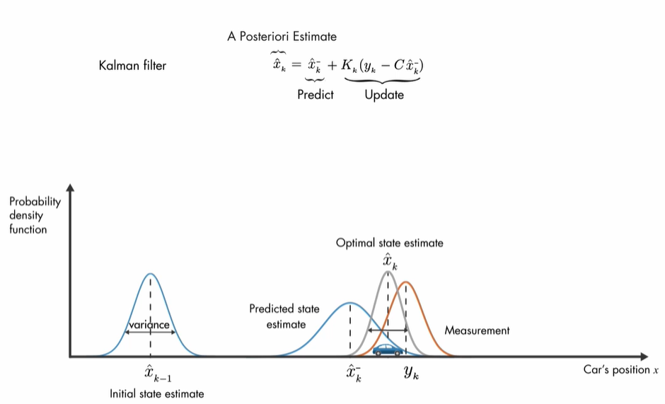
Notes:
We can now rewrite the equation like this. The second part of the equation uses the measurement and incorporate it into the prediction to update the a priori estimate. And we'll call the result the a posteriori estimate.

Slide 63
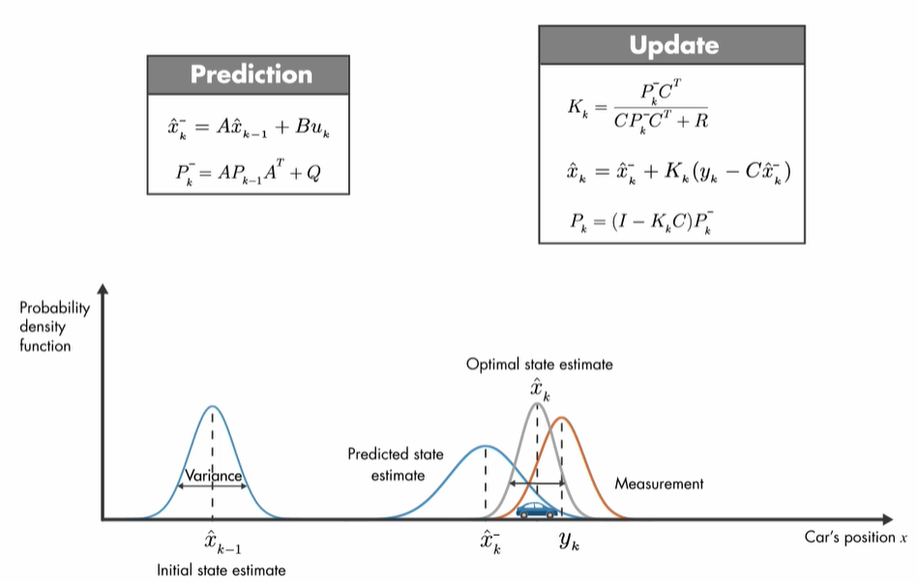
Notes:
You want to win the big prize, right? Then these are the equations you need to run on your car CCU.
Looks a little scary? What if we turn everything upside down? Doesn't change much, does it? Okay, we'll go over the algorithm equations step by step

Slide 64
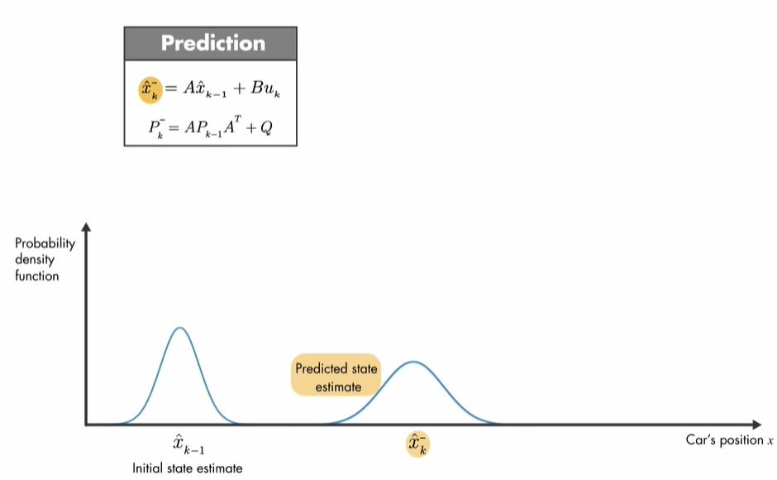
Notes:
The Kalman filter is a two-step process. Let's first start with the prediction part. Here, the system model is used to calculate the a priori state estimate

Slide 65
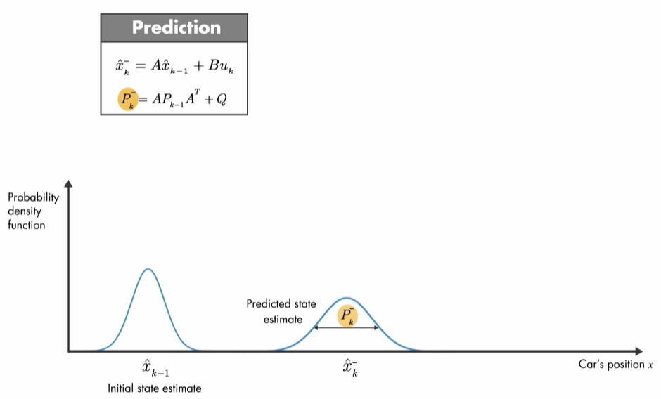
Notes:
and the error covariance p.
For our single-state system, p is the variance of the a priori estimate, and it can be thought of as a measure of uncertainty in the estimated state. This variance comes from the process noise and propagation of the uncertain x hat k minus 1.

Slide 66
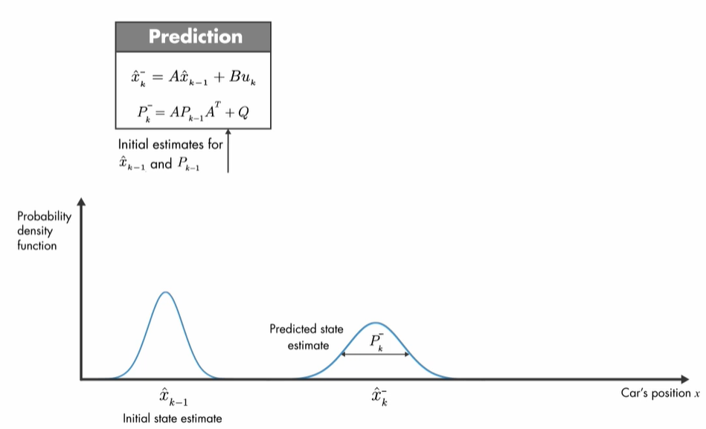
Notes:
At the very start of the algorithm, the k minus 1 values for x hat and p come from their initial estimates.

Slide 67
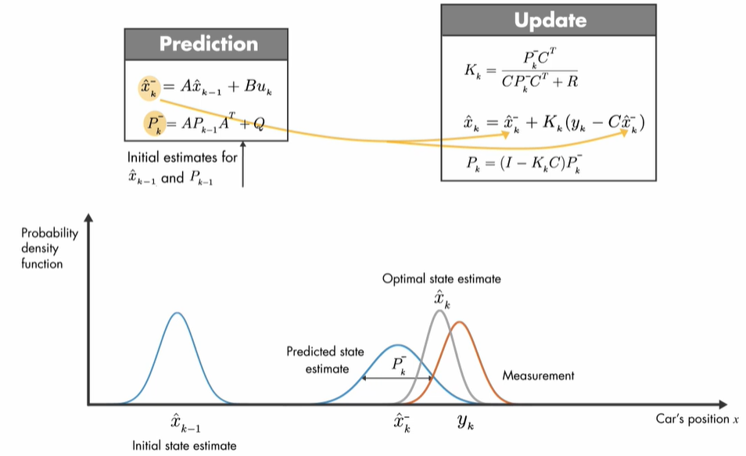
Notes:
The second step of the algorithm uses the a priori estimates calculated in the prediction step and updates them to find the a posteriori estimates of the state and error covariance.

Slide 68

Notes:
and updates them to find the a posteriori estimates of the state and error covariance

Slide 69

Notes:
of the state and error covariance

Slide 70

Notes:
The Kalman gain is calculated such that it minimizes the a posteriori error covariance.

Slide 71

Notes:
Let this bar represent the calculation of x hat k. By weighing the correction term, the Kalman gain determines how heavily the measurements and the a priori estimates contributes to the calculation of x hat k.

Slide 72

Notes:
If the measurement noise is small, the measurements is trusted more and contributes to the calculation of x hat k more than the a priori state estimate does.

Slide 73

Notes:
In the opposite case, where the error in the a priori estimate is small, the a priori estimate is trusted more. And the computation of x hat k mostly comes from this estimate.
.

Slide 74


Notes:
We can also show this mathematically by looking at two extreme cases. Assume that in the first case, the measurement covariance is 0. To calculate the Kalman gain, we take its limit as r goes to 0. We plug in 0 for r and see that these two terms cancel each other out.

Slide 75


Notes:
As r goes to 0, the Kalman gain approaches to the inverse of c, which is equal to 1 in our system. Plugging k, an inverse of c, into the a posteriori set estimate shows that x hat k is equal to yk. So the calculation comes from the measurement only as expected.
Now, if we update our plot, we can show the measurement with an impulse function, which is shown with this orange vertical line. Note that the variance in the measurement is 0, since r goes to 0. We found that the a posteriori estimate is equal to the measurement, so we can show it by the same impulse function.

Slide 76

Notes:
On the other hand, if the a priori error covariance is close to 0, then the Kalman gain is form as 0. Therefore, the contribution of this term to x hat k is ignored, and the computation of x hat k comes from the a priori state estimates. On the plots, we'll show the a priori state estimate with an impulse function, which has zero variance.
And since the a posteriori estimate is equal to the a priori estimate, we'll show it with the same impulse function

Slide 77

Notes:
Once we've calculated the updated equations, in the next timestep, the a posteriori estimates are used to predict the a priori estimates, and the algorithm repeats itself.
Notice that to estimate the current state, the algorithm doesn't need all the past information. It only needs the estimated state and error covariance matrix from the previous timestep and the current measurement. This is what makes the Kalman filter recursive.
http://www.ilectureonline.com/lectures/subject/SPECIAL%20TOPICS/26/190/1966

